Slide 1
UMD DATA605 - Big Data Systems Course Intro Data Models Relational DBs and SQL Intro
GP Saggese
gsaggese@umd.edu
with thanks to
Alan Sussman
Amol Deshpande

Slide 2
UMD DATA605 - Big Data Systems Course Intro Data Models Relational DBs and SQL Intro

Slide 3
Class Overview
Goals/Objectives
Learn to model and reason about data
Learn how to process and manipulate data in different ways
Introduce a variety of data models
Decide which data model is appropriate for different application scenarios
Learn to use a variety of data management systems
Decide which system is appropriate for a given data management scenario

Slide 4
Class Overview
~6 Projects / labs: 50%
Individually done
Midterm + Final: 50%
Will re-evaluate based on how initial labs go
Grad and undergrad students will be assigned final grades separately
First project should be posted by Monday, so we can discuss next week
PostgreSQL
Check out the class web pages

Slide 5
Class Overview
Some tools we will learn how to use:
Languages: Python
Dev tools:
Bash / Linux OS
Git (branching, understand data model)
GitHub (PRs, fork)
Code editors (PyCharm, Visual Studio, vim / emacs)
Data science libs (Pandas, sklearn, matplotlib)
Jupyter
Docker
Unit testing framework
Data Management Tools
ETL pipelines
Workflow manager (Airflow)
Relational databases (PostgreSQL)
NoSQL (HBase, MongoDB, Couchbase)
Graph DBs (Neo4j, OrientDB, AllegroGraph, GraphX, Giraph
Hadoop, Spark, Dask, Storm, Spark Streaming
AWS Cloud Services
Instructions will be provided to get started for each tool we use for a project

Slide 6
Non-technical skills needed at work
Misc skills people coming out from college often don’t have
How to work in a team
Design software architecture
External documentation
How to comment code
Reading other people code
How to follow code conventions (PEP8, Google Code)
Write code so that other people can understand (including future-you)
Being clear in communications (e.g., in emails, Slack)
How to file a bug
How to repro a bug

Slide 7
Course map
Data model
ETL

Slide 8
Why I am interested in Big Data

Slide 9
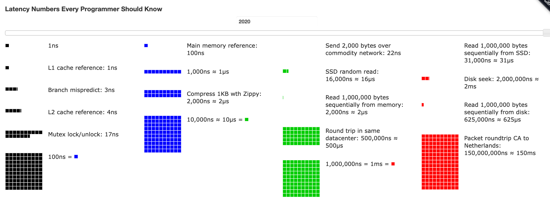
Constants that everybody should know
From here
A CPU running at 3GHz executes an instruction every .3ns
L1 Cache reference / register 1ns
L2 Cache reference: 4ns
Main mem reference: 100ns
Send 2KB over network: 22ns
SSD random read: 16us
Disk seek: 2ms
Packet round-trip from CA to Netherland: 150ms

Slide 10
Scale of data sizes
Petabyte = 1000 TB, 1m GB
Exabyte = 1m TB, 1b GB
Zetabyte = 1b TB ($10^21$)
Yottabytes = $10^24$ bytes
Brontobytes = $10^27$ bytes

Slide 11
Some To-Dos
Make sure you are signed up for Piazza!
Begin setup of your computing environment
Install Docker on your laptop

Slide 12
UMD DATA605 - Big Data Systems Course Intro Big data
Data models Relational DBs and SQL Intro

Slide 13
Motivation: Data Overload
McKinsey, 2013: data science is the number one catalyst for economic growth
Growing amount of data
Cloud computing
Big data builds better machine models to make better business decisions
Explosion of data in every domain
Sensing devices / networks monitor 24/7 (e.g., temperature, pollution, vital signs)
Increasingly sophisticated smart-phones (6.5b smart phones, 80% of the population)
Internet and social networks makes it easy to publish data
Scientific experiments and simulations produce enormous volumes of data
Internet of Things
Datafication: turn all aspects of life into data
E.g., what you like/enjoy turned into a stream of your "likes”
Challenges
How to handle that data?
How to extract interesting actionable insights and scientific knowledge?
Data volumes expected to get much bigger

Slide 14
Big data applications
Personalized marketing
Target each consumer instead of the consumers at large
E.g., Amazon personalizes suggestions using signals
From your shopping history
From what you have searched for (or watched)
From other consumers and trends
From reviews (through NLP and sentiment analysis)
Brands can use sentiment analysis to understand how customers related to products
Positively, negatively, neutral

Slide 15
Big data applications
Mobile advertisement
Mobile phones are ubiquitous
Integration of on-line (e.g., GPS location) and off-line databases
E.g.,
I’ve bought a new house,
I google questions about renovations
Google can send me coupons for the closest Home Depot

Slide 16
Big data applications
Biomedical data
Personalized medicine
Patients can receive treatment tailored to them to maximize efficacy
Genetics, daily activities, environment, habits
Genome sequencing

Slide 17
Big data applications
Smart cities
Interconnected mesh of sensors in smart cities
E.g., traffic sensors, camera networks, satellites
Monitor pollution
Minimize traffic congestion
Optimal urban services
Maximize energy savings

Slide 18
Goal
Data > Information > Knowledge > Wisdom
Combine streams of big data to generate new insights
New data can be “big data” itself
Insights enable decisions and actions

Slide 19
Four V’s of Big Data
Volume
Vast amount of data is generated
Variety
Different forms
E.g., text, images, voice, geospatial data
Velocity
Speed at which data is generated
Veracity
Biases, noise, abnormality in data
Uncertainty, trustworthiness
(Valence)
Connectedness of big data in the form of graphs
(Value)
Challenges of big data can distract from focusing on how big data benefit the organization

Slide 20
Four V’s of Big Data
Volume
Exponentially increasing amount of data
Every day 2.5 exabytes (1m of TB) of data is generated
90% of all data in the world was generated in the last 2 years
Total amount of stored data doubles every 1.2 years
500M tweets per day (2016)
Google processes 3.5b queries / day (2018)
2.5 Exabytes of data created every day (IBM, 2012)
eBay: Two data warehouses with 7.5PB and 40PB
Walmart: 583TB of sales and inventory data
Scientific data:
1.5GB/genome (can be sequenced in .5 hrs)
LHC generates 100TB of data a day

Slide 21
Four V’s of Big Data
Variety
Structured data (e.g., spreadsheets, relational data)
Semi-structured data (e.g., natural language text, sales receipts, your class notes)
Unstructured data (e.g., photos, videos)
Different formats (e.g., flat files, CSV, XML, JSON)
Velocity
Sensors everywhere
Can generate tremendous volumes of "data streams"
Sometimes data can be processed off-line
Real-time analytics requires data to be consumed as fast as it is generated
Veracity
How do you decide what to trust?
How to remove noise?
How to fill in missing values?

Slide 22
Sources of big data
Machines
People
Organization

Slide 23
Sources of big data
Machines
Real-time sensors (e.g., sensors on Boeing 787)
Scientific experiments
Cars
Website tracing
Personal health tracker
Pros
Highly structured
Cons
Compute data in-situ or in centralized fashion

Slide 24
Sources of big data
People
Social media (e.g., Facebook, Instagram, Twitter, LinkedIn)
Video sharing (e.g., YouTube, TikTok)
Blogging and commenting
Internet searches
Text messages (e.g., phones and Whatsapp, Signal, Telegram)
Personal documents (e.g., Google Docs)
Pros
Highly valuable for business intelligence
Cons
Typically unstructured data
Text-heavy
It takes investment before you can reap the value
Acquire -> Store -> Clean -> Retrieve -> Process

Slide 25
Sources of big data
Organization
Commercial transactions
Credit cards
E-commerce
Banking
Financial information
Medical records
Sensors
Transactions
Clicks on a website
Store every event in the past to predict the future
Pros
Highly structured
Cons
Stored in “data silos” with different data models
Each department has its own data system
Missing opportunities
Data is outdated, not visible
Cloud computing helps

Slide 26
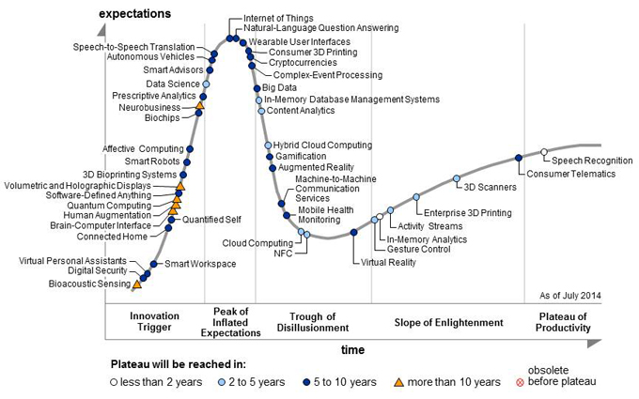
Big Data + Data Science to the Rescue
Big data and data science increasingly used synonymously:
Aka data analytics, data mining, business intelligence, predictive analytics
Loosely used for any process where interesting things are inferred from data
Data scientist called the “sexiest job” of the 21st century
The term has becoming very muddled at this point
Hype / overhype

Slide 27
Is it all hype?
No
Extracting insights and knowledge from data very important
Will continue to increase in importance
Big data techniques are revolutionizing things in many domains (e.g., education, food supply, disease epidemics, …)
But
Not much different from what we, especially statisticians, have been doing for many years
What is different?
Much more data is digitally available than was before
Cloud computing + easy-to-use programming frameworks (e.g., Hadoop, Spark) = much easier to analyze it
Often large-scale data + simple algorithms > small data + complex algorithms

Slide 28
Key Shifts
From: Rise of Big Data
Curated, clean, small samples → large, uncurated, messy datasets
Before:
Statistics based on small, carefully collected random samples
Costly, hard to do fine-grained analysis, careful planning
Today:
Collect huge volume of data
Feed it into algorithms
Usually the signal is strong enough to overcome the noise

Slide 29
Key Shifts
Causation → Correlation
Goal of analysis often to figure out what caused what
Causation very hard to figure out
Today: give up causation for correlation -- we can find out two things are correlated and often that's enough
"Datafication": process of converting abstract things into concrete data
E.g., what you like represented as a stream of your likes
Your "sitting posture" captured using 100's of sensors placed in a car seat

Slide 30
Examples
Nate Silver and the 2012 Elections
Some reasons why he got things right:
Many sources of data, irrespective of quality
Incorporation of historical accuracy
Understanding correlations
Monte-Carlo simulations to compute the probabilities of electoral college
Didn’t work that well in 2020

Slide 31
Examples
Google Flu Trends
Early warning of flu outbreaks by analyzing search queries
Up to 1 or 2 weeks ahead of CDC
Analyzed 50m search queries to see which of them fit the physician visits for flu
45 search terms used to create a single model
Caveat: accuracy not as good any more
NY Times Article

Slide 32
Defining Data Science / Big Data
Very ambiguous and ill-defined term
Drew Conway's Venn Diagram

Slide 33
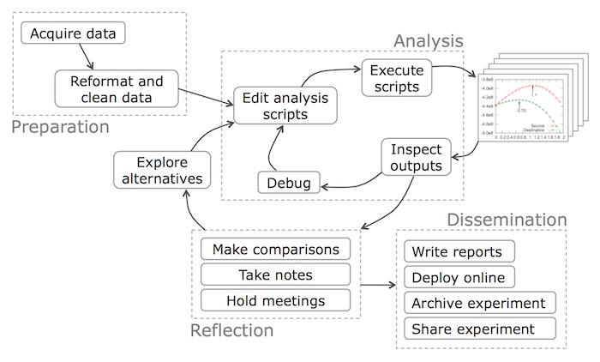
Typical Data Science Workflow
From Data Science Workflow; Phillip Guo

Slide 34
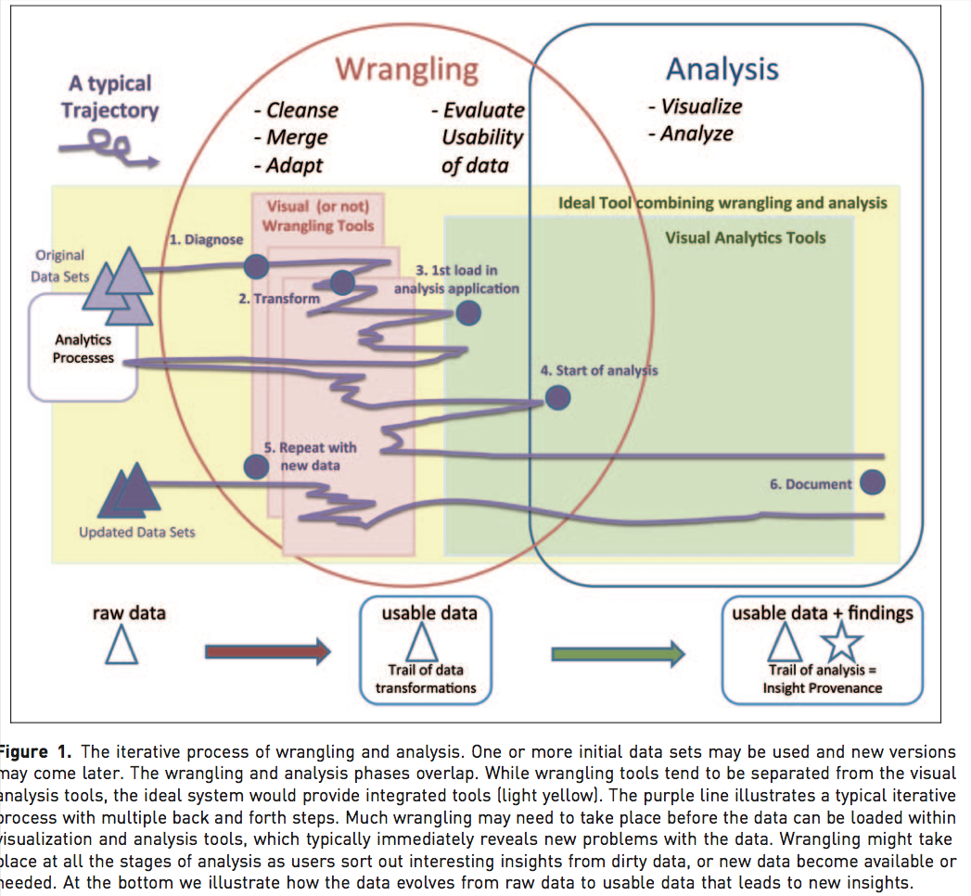
Where Data Scientist Spends Most Time
'Janitor Work' in Data Science;
Research Directions in Data Wrangling
Estimates that 80-90% of the work is in data cleaning and wrangling

Slide 35
What a Data Scientist Should Know
From: How to hire a data scientist
Data grappling skills
How to move data around and manipulate it with some programming language
Scripting languages (e.g., Python)
Data storage tools like relational databases, key-value stores
Programming frameworks like SQL, Hadoop, Spark, etc.
Data visualization experience
How to draw informative pictures of data
Many tools (e.g., D3.js, plotting libraries)
Harder question is knowing what to draw
Knowledge of statistics
E.g., error-bars, confidence intervals
Python libraries; Matlab; R
Experience with forecasting and prediction
Basic machine learning techniques
Communication skills
Communicate the findings
We focus here!!!

Slide 36
UMD DATA605 - Big Data Systems Course Intro
Big data Data Models Relational DBs and SQL Intro

Slide 37
Overview
Data Modeling
= process of representing / capturing the structure and properties of real-world entities
Data model
Description of how data is represented (e.g., relational, key-value) and accessed (e.g., allowed operations, how to query)
E.g., schema in a DB is the description of a specific collection of data, using a given data model
Real-world -> representation
Why?
Need to know the structure of the data (to some extent) to be able to write general purpose code
Allows to share data across programs, organizations, systems
Need to be able to integrate information from multiple sources
Efficiency: can preprocess data to make access efficient (e.g., building a B-Tree on a field)

Slide 38
Overview
A data model typically consists of:
Modeling constructs
A collection of concepts used to represent the structure in the data, e.g.,
types of entities
entity attributes
types of relationships between entities
relationship attributes
Integrity constraints
Constraints to ensure data integrity (e.g., avoid errors)
Manipulation languages
Constructs for manipulating the data
Inserting, accessing, updating, deleting

Slide 39
Overview
We would like a data model to be:
Sufficiently expressive
Capture real-world data well
Easy to use
Lends itself to good performance
The evolution of data modeling tools as an attempt to capture the structure in the data
Structured data -> Relational DBs
Semi-structured web data -> XML
Unstructured data -> NoSQL DBs

Slide 40
Overview
Some examples of data models
Relational, entity-relationship model, XML, ...
Object-oriented, Object-relational, RDF, ...
Current favorites in the industry: JSON, Protocol Buffers, Avro, Thrift, Property Graph
Why so many data models ?
Tension between descriptive power and ease of use/efficiency
More powerful models
More datasets can be represented
Harder to use, to query, and less efficient

Slide 41
Entity-relationship (ER) model
Object-oriented DB
Object-relational DB
OOP

Slide 42
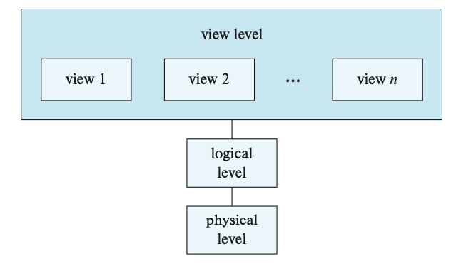
Overview
Typically there are multiple levels of modeling
Physical
How the data is physically stored
Complex data structures (e.g., B-trees)
Logical
Type of information stored, different entities, their attributes, and the relationships among those
Views
Restrict information flow
Security and/or ease-of-use

Slide 43
Overview
Data independence
Can change the representation of data without changing programs that operate on it
Physical data independence
Can change the layout of data on disk and programs won't change
Index the data
Partition/distribute/replicate the data
Compress the data
Sort the data

Slide 44
Databases: A Brief History
1960's: Computers finally become attractive, and enterprises start using it
Most applications initially used their own data stores
Database: coined in military information systems to denote "shared data banks" by multiple applications
Each application had its own format
Data was basically unavailable to other programs
Instead, define a data format, store it as a "data dictionary", and allow general-purpose "database management" software to access it
Issues:
How to write data dictionaries?
How to access data?
Disadvantages of integration: integrity, security, privacy concerns
Who controls the data?
Notes:
Silber 1.9

Slide 45
Databases: A Brief History
Birth of "hierarchical model" and "network model"
Both allowed "connecting" records of different types (e.g., connect "accounts" with "customers")
Network model attempted to be very general and flexible
IBM designed its IMS hierarchical database in 1966 for the Apollo space program; still around today
.. more than 95 percent of the top Fortune 1000 companies use IMS to process more than 50 billion transactions a day and manage 15 million gigabytes of critical business data (from IBM Website on IMS)
Predates hard disks
However, both models exposed too much of the internal data structures/pointers etc. to the users

Slide 46
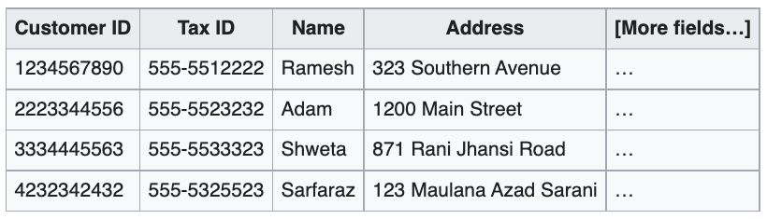
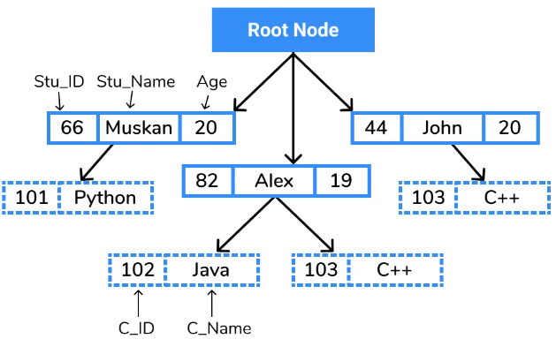
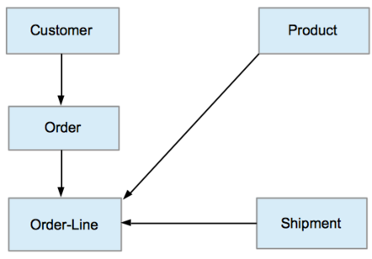
Relational model
Data is represented as tuples grouped in relations
Hierarchical model
Each record has one parent record and many children
Data is organized into a tree-like structure
Records connected through links
Resurgence in 1990s with XML DBs
Network model
Each record can have multiple parent and child records
Forming a graph
Resurgence in 2010s with graph DBs

Slide 47
Databases: A Brief History
1970's: Relational Model
Origins in Set Theory, First-order predicate logic
Edgar F. "Ted" Codd: Developed the relational model
Elegant, formal model that provided almost complete data independence
Users didn't need to worry about how the data was stored, processed etc.
High level query language (relational algebra)
Notion of normal forms
Allowed one to reason about and remove redundancies

Slide 48
Databases: A Brief History
Led to two influential projects: INGRES (UC Berkeley), System R (IBM)
Also paved the way for a 1977 startup called "Software Development Laboratories"
Didn't care about IMS/IDMS compatibility (as IBM had to)
Many debates in the early 70's between Relational Model proponents and Network Model proponents
Don Chamberlin of IBM was an early CODASYL advocate (later co-invented SQL)
He (Codd) gave a seminar and a lot of us went to listen to him. This was as I say a revelation for me because Codd had a bunch of queries that were fairly complicated queries and since I'd been studying CODASYL, I could imagine how those queries would have been represented in CODASYL by programs that were five pages long that would navigate through this labyrinth of pointers and stuff. Codd would sort of write them down as one-liners. These would be queries like, "Find the employees who earn more than their managers." [laughter] He just whacked them out and you could sort of read them, and they weren't complicated at all, and I said, "Wow." This was kind of a conversion experience for me, that I understood what the relational thing was about after that.
Notes:
Software Development Laboratories is Oracle
CODASYL is network DB model and query language

Slide 49

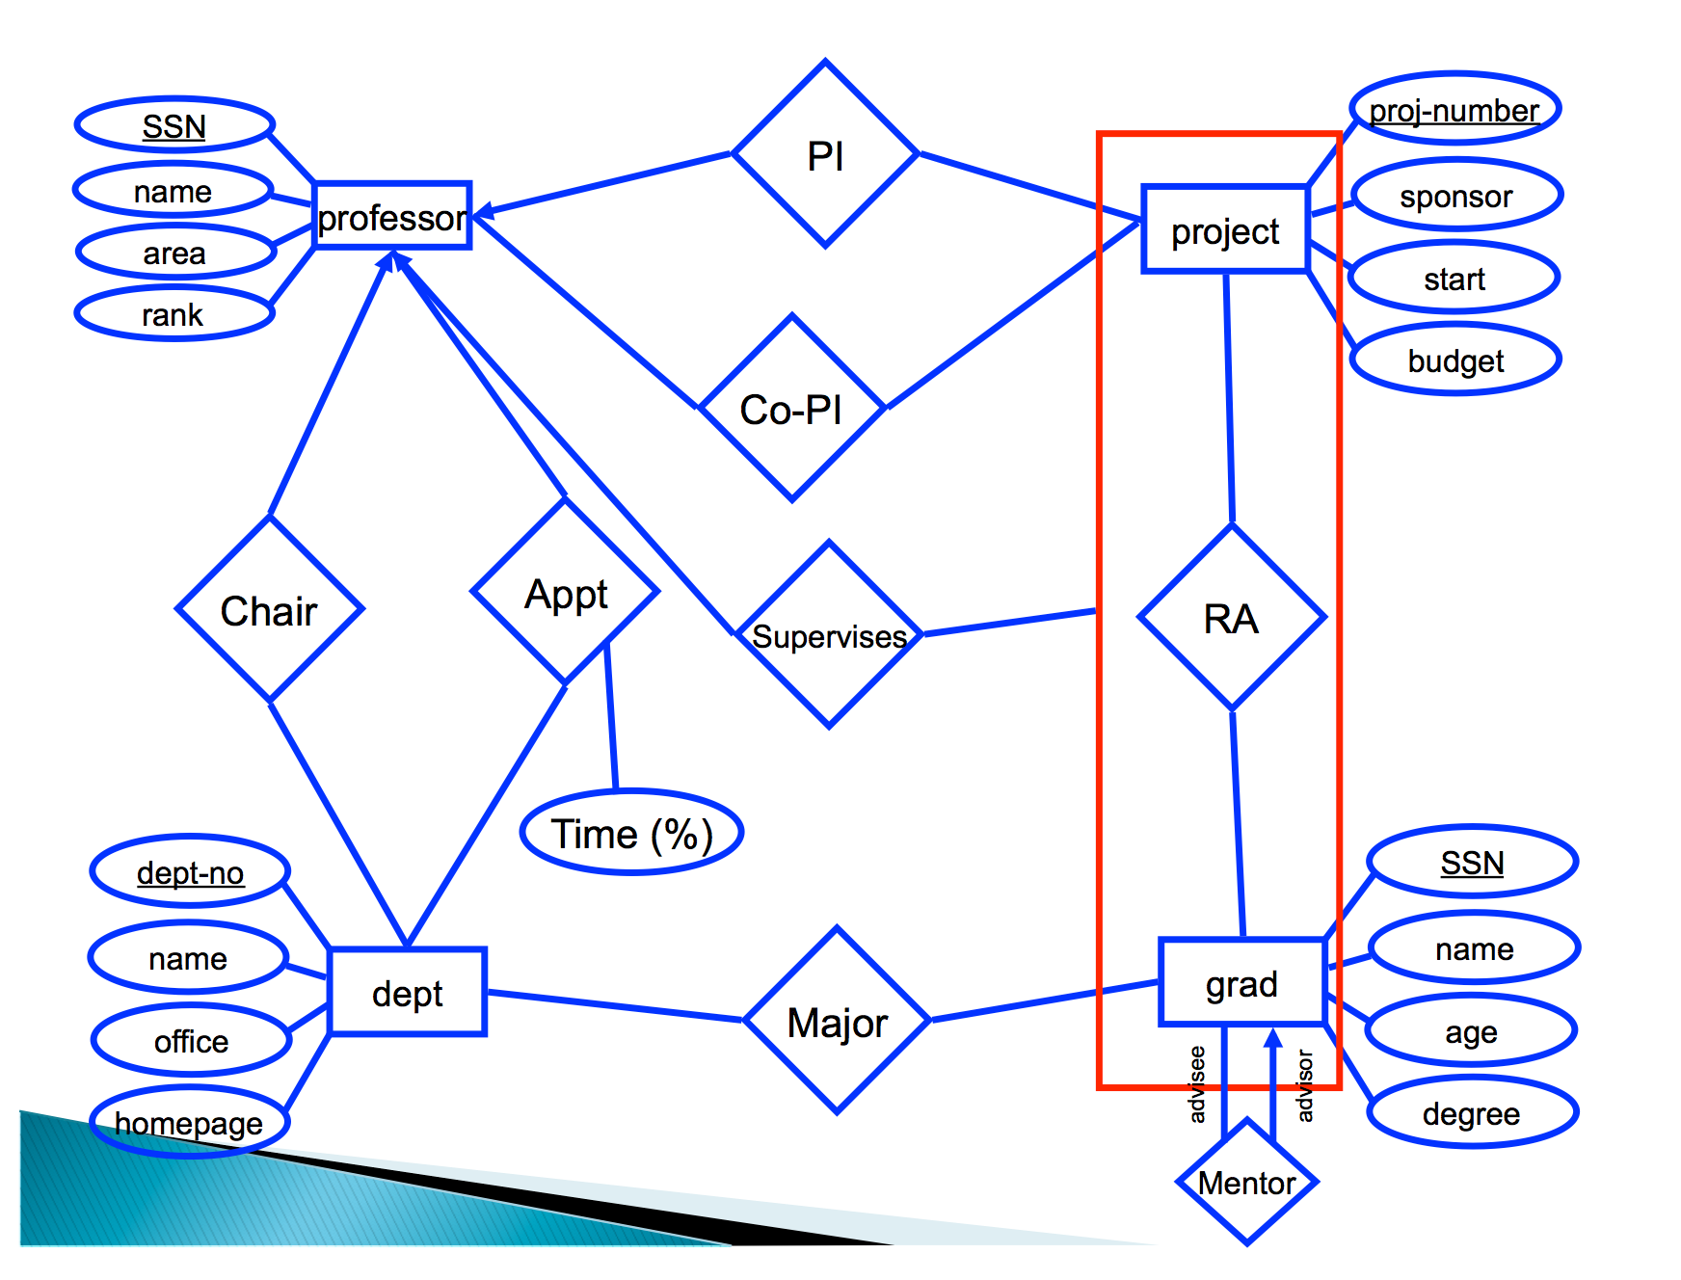
Entity-Relationship model
1976: Peter Chen proposed "Entity-Relationship Model"
Allowed higher-level, conceptual modeling
Entities are physical or logical objects that can be uniquely identified
“Nouns”
Relationships between entities
“Verbs”
An ER model can be mapped on a relational DB
Notes:
Entities are nouns – rectangles in diagram
Relationships are verbs – diamonds in diagram
Both can have attributes – circles in diagram

Slide 50
Databases: A Brief History
1980: Commercialization / widespread acceptance of relational model
SQL emerged as a standard, in large part because of IBM's backing
Enriching the expressive power of relational model
Set-valued attributes, aggregation, generalization, etc.
Late 80's
Object-oriented DB
Store objects instead of tables
Get around impedance mismatch between programming languages and databases
Object-relational DB
Allow user-defined types
Get many benefits of object-oriented while keeping the essence of relational model
No real differentiation today from pure relational model
Other proposals for semantic data models

Slide 51
Object-Oriented Programming
It is a data model
Object behavior is described through data (stored as fields) and code (in the form of methods)
Composition
has-a relationships
E.g., an Employee class has an Address class
Inheritance
is-a relationships
E.g., an Employee class derives from a Person class
Polymorphism
Code executed depends on the class of the object
E.g., `draw()` method on a Circle vs Square object (both descending from Shape class)
One interface, many implementations
Encapsulation
E.g., private, public fields / members
Prevents external code from being concerned with inner workings of an object

Slide 52
Databases: A Brief History
Late 90's-today: XML: eXtensible Markup Language
Intended for semi-structured data
Flexible schema
Tree-like
<?xml version="1.0" encoding="UTF-8"?> <!-- Edited by XMLSpy --> <CATALOG>
<CD> <TITLE>Empire Burlesque</TITLE>
<ARTIST>Bob Dylan</ARTIST>
<COUNTRY>USA</COUNTRY>
<COMPANY>Columbia</COMPANY>
<PRICE>10.90</PRICE> <YEAR>1985</YEAR> </CD> <CD> <TITLE>Hide your heart</TITLE> <ARTIST>Bonnie Tyler</ARTIST> <COUNTRY>UK</COUNTRY> <COMPANY>CBS Records</COMPANY> <PRICE>9.90</PRICE> <YEAR>1988</YEAR> </CD> ...

Slide 53
Resource Description Framework
Aka RDF
Originally intended as a "metadata data model"
Key construct: a "subject-predicate-object" triple
E.g.,
subject=sky
predicate=has-the-color
object=blue
Direct mapping to a labeled, directed multi-graph
Typically stored in relational databases, or what are called "triple-stores”

Slide 54
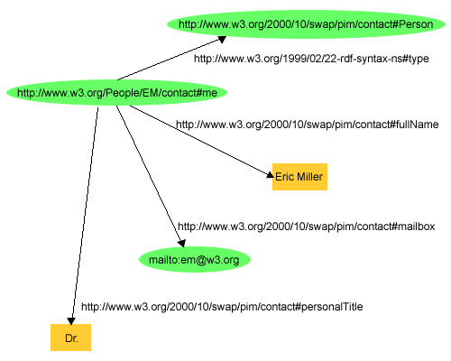
RDF Example
<rdf:RDF xmlns:contact="http://www.w3.org/2000/10/swap/pim/contact#" xmlns:eric="http://www.w3.org/People/EM/contact#" xmlns:rdf="http://www.w3.org/1999/02/22-rdf-syntax-ns#"> <rdf:Description rdf:about="http://www.w3.org/People/EM/contact#me"> contact:fullNameEric Miller</contact:fullName> </rdf:Description> <rdf:Description rdf:about="http://www.w3.org/People/EM/contact#me"> <contact:mailbox rdf:resource="mailto:e.miller123(at)example"/> </rdf:Description> <rdf:Description rdf:about="http://www.w3.org/People/EM/contact#me"> contact:personalTitleDr.</contact:personalTitle> </rdf:Description> <rdf:Description rdf:about="http://www.w3.org/People/EM/contact#me"> <rdf:type rdf:resource="http://www.w3.org/2000/10/swap/pim/contact#Person"/> </rdf:Description> </rdf:RDF>

Slide 55
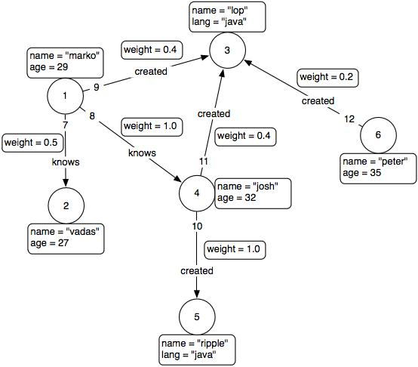
Property Graph Model
Developed for graph databases
A vertex- and edge-labeled graph
Properties associated with each edge and vertex

Slide 56
JSON
JSON = JavaScript Object Notation
Very similar to XML and seems to be replacing it for many purposes
More human-readable
{ "firstName": "John", "lastName": "Smith", "isAlive": true, "age": 25, "height_cm": 167.6, "address": { "streetAddress": "21 2nd Street", "city": "New York", "state": "NY", "postalCode": "10021-3100" },
"phoneNumbers": [ { "type": "home", "number": "212 555-1234” }, { "type": "office", "number": "646 555-4567" } ], "children": [], "spouse": null }

Slide 57
Serialization formats
Need a way for programs/systems to send data to each other (on the network, on disk)
Several recent technologies all based around schemas

Slide 58
Protocol Buffers
Protocol Buffers:
Developed by Google
Schema is mostly relational, with support for optional fields and some other constructs
Schema specified using a .proto file
Compiled by protoc to produce C++, Java, or Python code
message Person { required int32 id = 1; required string name = 2; optional string email = 3; }
Person person; person.set_id(123); person.set_name("Bob"); person.set_email("bob@example.com"); fstream out("person.pb", ios::out | ios::binary | ios::trunc); person.SerializeToOstream(&out); out.close();

Slide 59
Serialization formats
Avro: Richer data structures, JSON-specified schema
Thrift: Developed by Facebook, now Apache project
Main goal to support Remote Procedure Calls across languages
{ "namespace": "example.avro", "type": "record", "name": "User", "fields": [ {"name": "name", "type": "string"}, {"name": "favorite_number", "type": ["int", "null"]}, {"name": "favorite_color", "type": ["string", "null"]} ] }

